Slide 1
Sharing with ZOOM
How to display your screens and resources

Slide 2
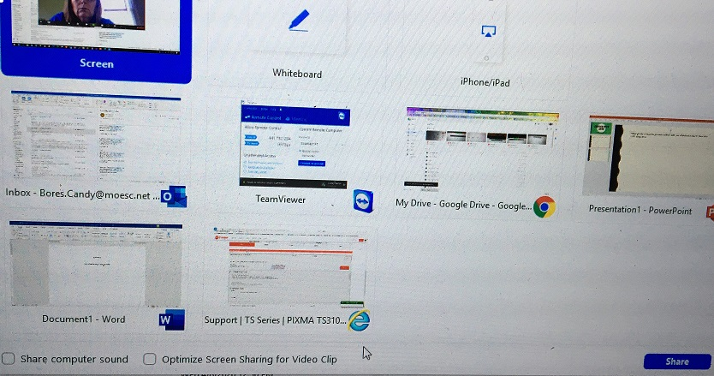
When you have resources you want to share with your students it is easy to share them while using zoom.
Load all the resources screen you will want to display, ex: Power point, word, smart notebook , video etc…
Hover over the bottom of the screen and choose the GREEN Share option
All you screens will be displayed and you click on the screen to be shown and then press the share in the bottom right corner.
If playing a video and need sound to be heard
check the checkboxes at the bottom of the screen
To change screens you will need to go to the
top of your screen / share toolbar and choose stop sharing
then change to the next screen or back to your screen/video feed.
The second bar shown is if you are using the whiteboard to display to your participants

